Slide 1
Internet Programming II
Chapter 4
Connecting to Database

Slide 2
Objectives
By the end of this chapter students will be able to:
Connecting PHP application and database
CRUD
Write secured code to prevent SQL injection, cross site scripting attack

Slide 3
Introduction
PHP offers various drivers for connecting to different types of databases, each tailored to specific database systems.
The choice of driver depends on the database being used and the specific requirements of the application, such as the need for prepared statements, object-oriented interfaces, or specific database feature.
It can connect to:
MySQL/MariaDB
PostgreSQL
SQLite
SQL Server (MSSQL)
Oracle
MongoDB

Slide 4
Installation
For development, you can use bundled software like XAMPP, LAMP, or MAMP, which includes MySQL/MariaDB.
For deployment, consider using cloud platforms or installing the database separately.
Now will use XAMPP
In XAMPP there is MariaDB and will use it
phpMyadmin is interface use to access MariaDB

Slide 5
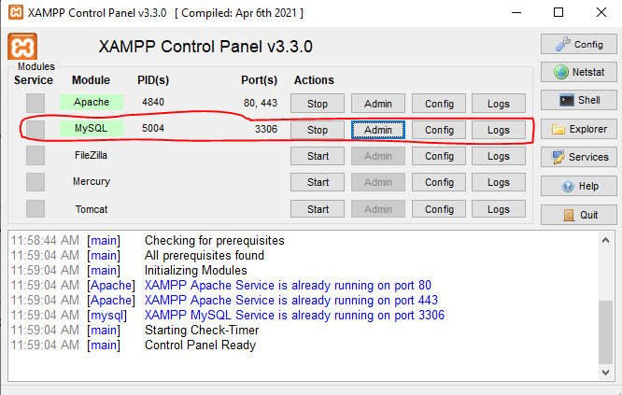
XAMPP Control Panel

Slide 6
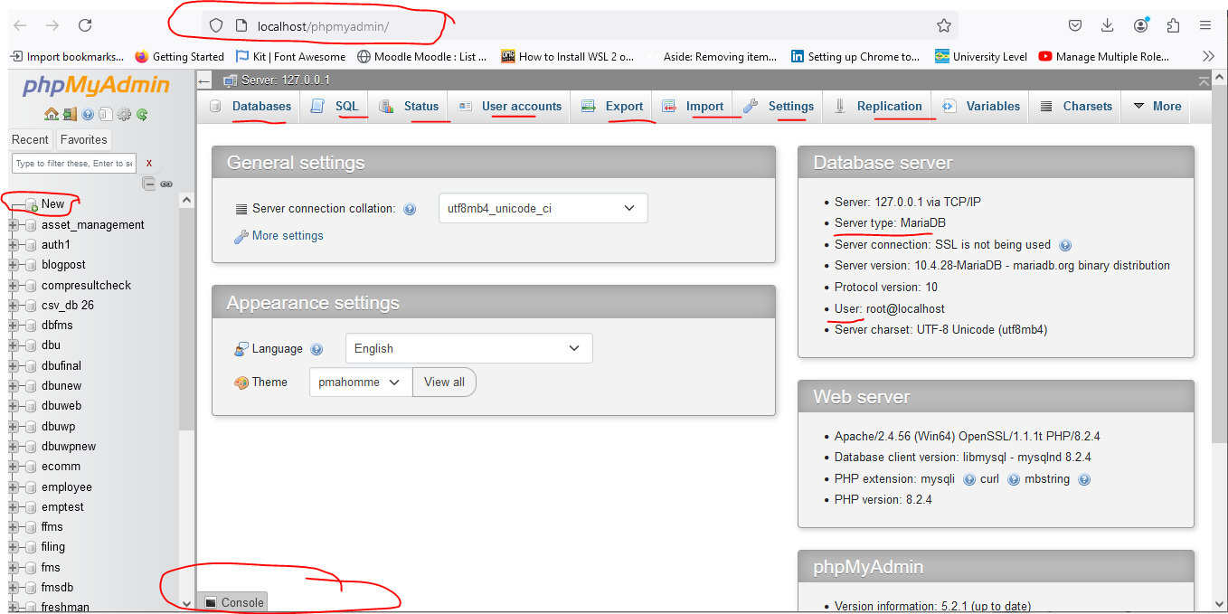
phpMyAdmin interface

Slide 7
Database operations
In phpMyAdmin, you can use both the GUI and SQL commands to easily perform various operations like
creating, renaming, and dropping databases;
creating tables; inserting, updating, and deleting data;
as well as searching, sorting, and more.

Slide 8
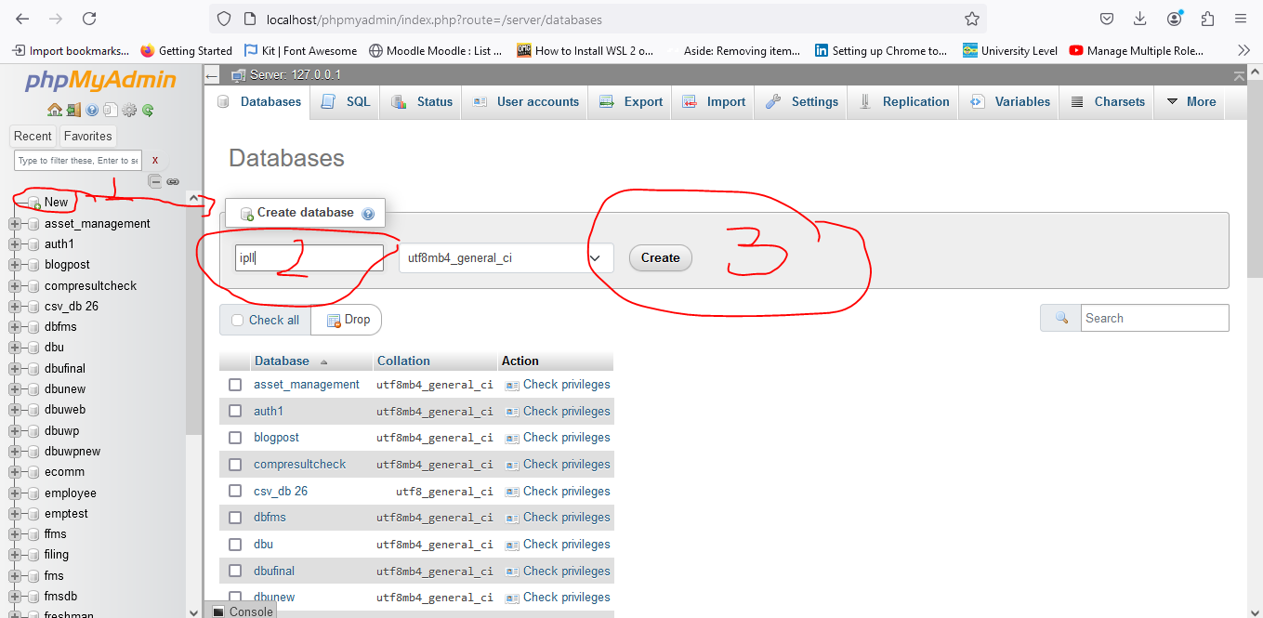
Create Database

Slide 9
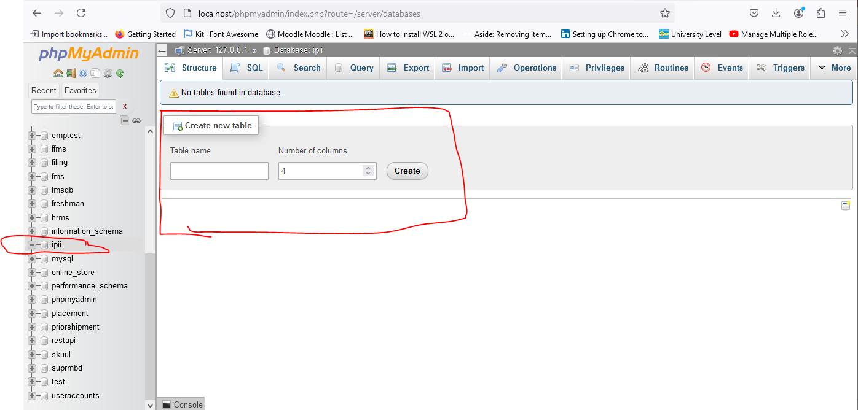
Create Database
The automatically open create table wizard
Now can write table name and specify number of column. Then click create

Slide 10
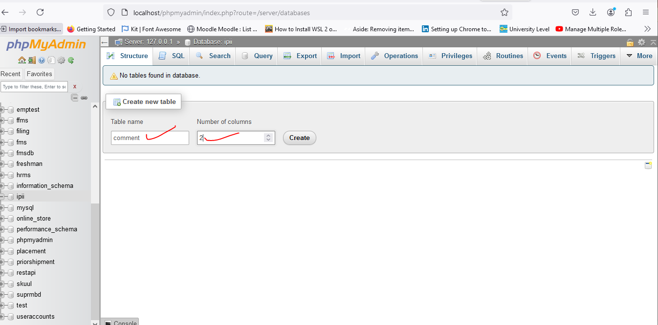
Create Table
Table name is comment and it has 2 columns

Slide 11
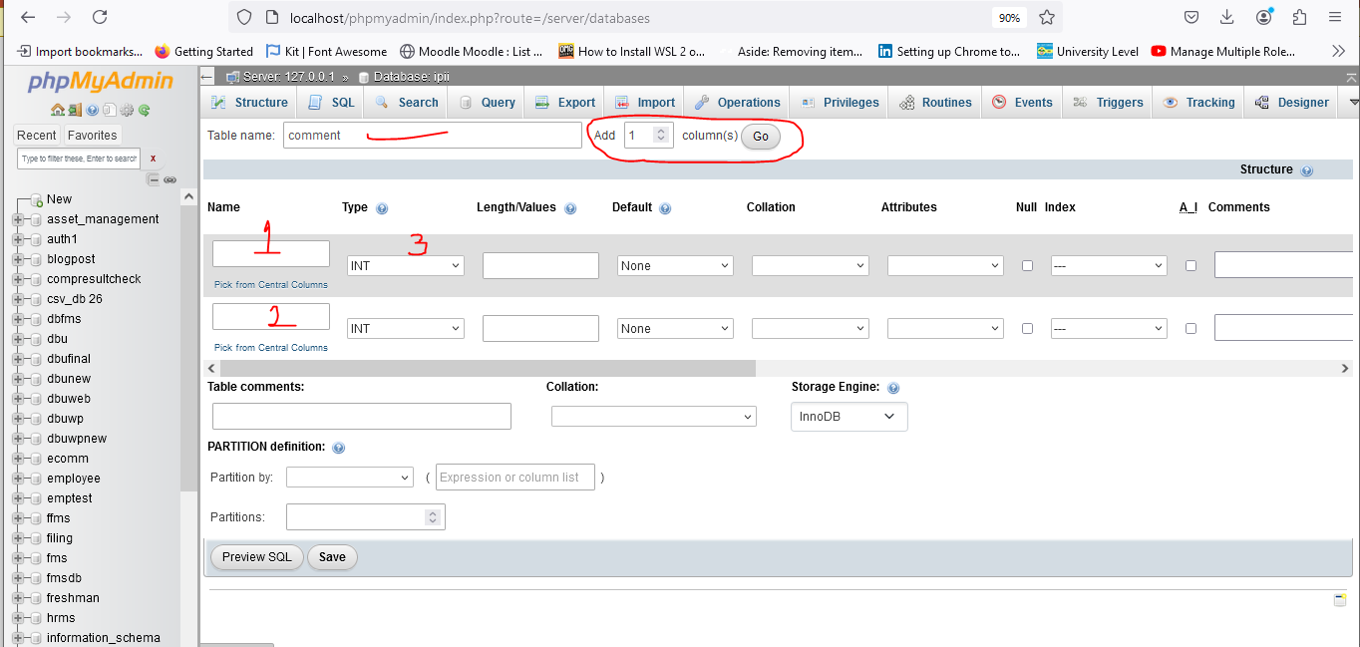
Create table

Slide 12
Create table
In number 1 and 2 the column name must written
In number 3 select data type of column
Then other columns value could be set as the requirement. Form example for this table will set id as primary key and auto increment. Comment as text data

Slide 13
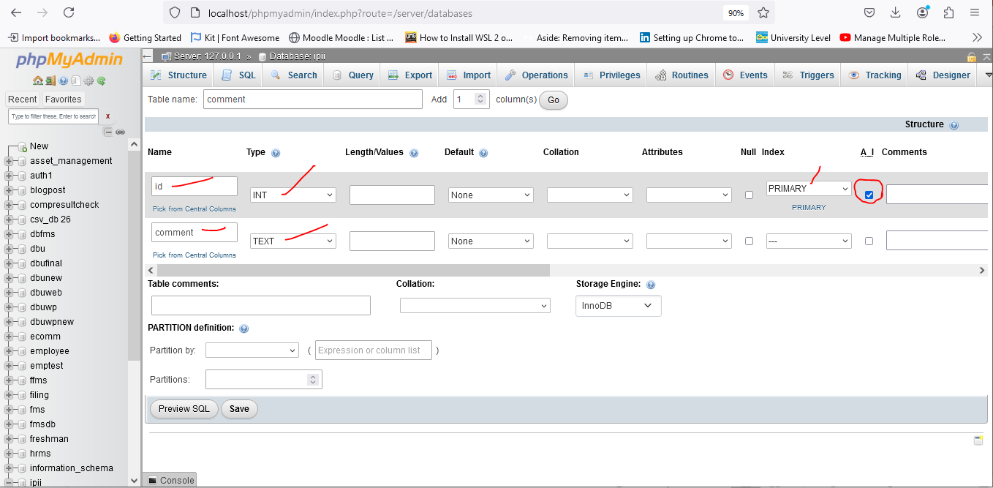
Create table

Slide 14
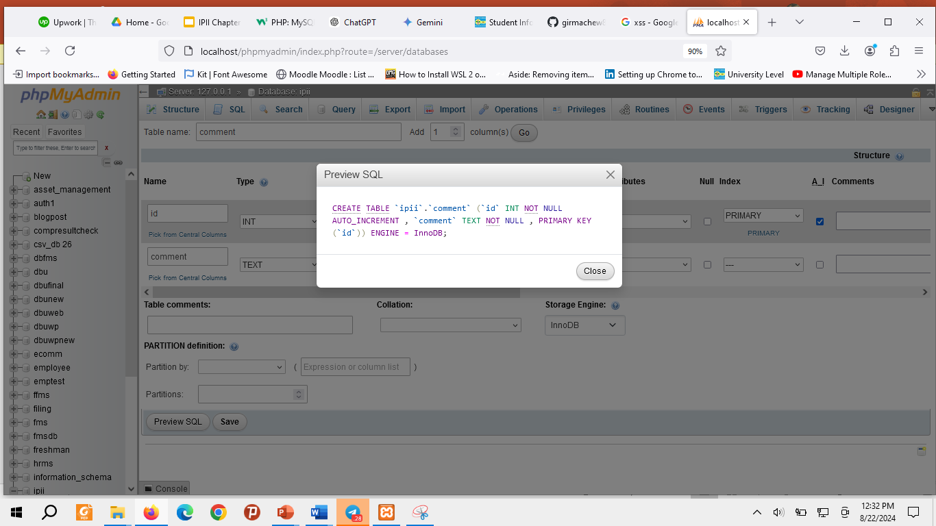
Create table SQL preview

Slide 15
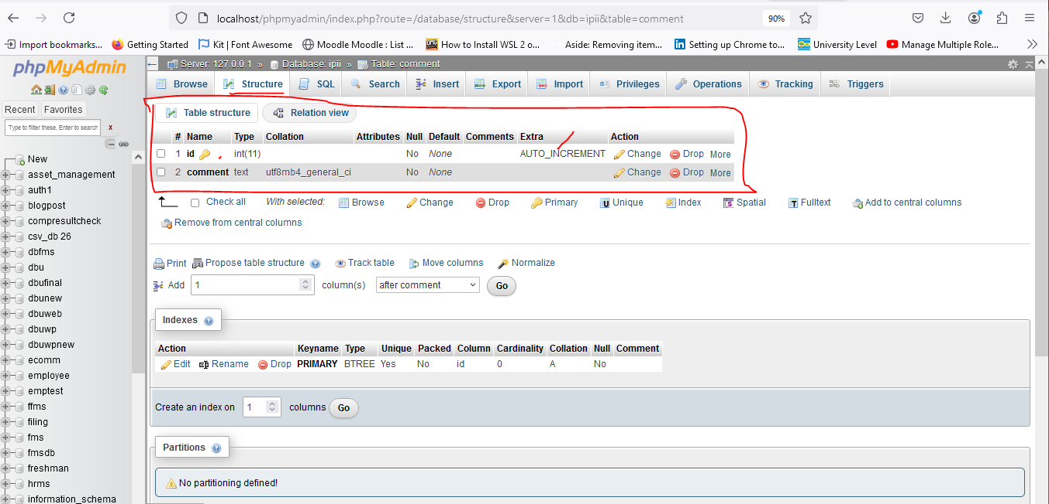
Created table structure

Slide 16
Connection
PHP 5 and later can work with a MySQL database using:
MySQLi extension (the "i" stands for improved)
PDO (PHP Data Objects)

Slide 17
Should I use MySQLi or PDO
PDO will work on 12 different database systems, whereas MySQLi will only work with MySQL databases.
So, if you have to switch your project to use another database, PDO makes the process easy. You only have to change the connection string and a few queries. With MySQLi, you will need to rewrite the entire code - queries included.
Both are object-oriented, but MySQLi also offers a procedural API.
Both support Prepared Statements.
Prepared Statements protect from SQL injection, and are very important for web application security.

Slide 18
Open the connection with MySql OOP
<?php
$servername = "localhost";
$username = "username";
$password = "password";
$dbname = "myDB";
// Create connection
$conn = new mysqli($servername, $username, $password, $dbname);
// Check connection
if ($conn->connect_error) {
die("Connection failed: " . $conn->connect_error);
}
echo "Connected successfully";
?>

Slide 19
Close the connection with MySql OOP
The connection will be closed automatically when the script ends.
To close the connection before, use the following:
MySQLi Object-Oriented: $conn->close();
MySQLi Procedural: mysqli_close($conn);
PDO : $conn = null;

Slide 20
Create Database and Table
After connection is opened different SQL commands will be run like create, drop, insert, select, update.
So, it is possible to create database and tables with PHP script.
Example
// Create database
$sql = "CREATE DATABASE myDB";
if ($conn->query($sql) === TRUE) {
echo "Database created successfully";
} else {
echo "Error creating database: " . $conn->error;
}

Slide 21
Connection with OOP
<?php
$servername = "localhost";
$username = "root";
$password = "";
$dbname = "ip22";
// Create connection
$conn = new mysqli($servername, $username, $password, $dbname);
// Check connection
if ($conn->connect_error) {
die("Connection failed: " . $conn->connect_error);
}else{
echo "Connected successfully";
}

Slide 22
Insert data
$sql = "INSERT INTO comment (comment)
VALUES ('Do not let')";
if ($conn->query($sql) === TRUE) {
echo "Comment saved successfully";
} else {
echo "Error: " . $sql . "<br>" . $conn->error;
}

Slide 23
Select single data
$sql = "SELECT * FROM comment WHERE id = 1";
$result = $mysqli->query($sql);
if ($result->num_rows > 0) {
$row = $result->fetch_assoc();
echo "ID : " . $row["id"] . " - Comment: " . $row["comment"]; } else {
echo "No results found";
}

Slide 24
Select Multiple data
$sql = "SELECT * FROM comment ";
$result = $mysqli->query($sql);
if ($result->num_rows > 0) {
while($row = $result->fetch_assoc()){
echo "ID : " . $row["id"] . " - Comment: " .$row["comment"].”<br>”;
}
}else {
echo "No results found";
}

Slide 25
Update data
$data ="Comment Three";
$sql = "UPDATE `comment` SET `comment`='$data' WHERE id = 3 ";
if ($conn->query($sql)) {
echo "Record updated successfully";
} else {
echo "Error updating record: " . mysqli_error($conn);
}

Slide 26
Delete data
$sql = "DELETE FROM `comment` WHERE id BETWEEN 4 and 8";
if ($conn->query($sql)) {
echo "Record deleted successfully";
} else {
echo "Error deleting record: " . mysqli_error($conn);
}

Slide 27
Alternatives to fetch_assoc
fetch_row(): Returns a numerical array where each column is indexed by its number.
if ($result->num_rows > 0) {
while ($row = $result->fetch_row()) {
echo "Column1: " . $row[0] . " - Column2: " . $row[1];
}
}
fetch_array(): Returns an array where each column is indexed by both its name and number.
$result = $mysqli->query($sql);
if ($result->num_rows > 0) {
while ($row = $result->fetch_array()) {
echo "Column1: " . $row['column1'] . " - Column2: " . $row[1];
}
}
fetch_object(): Returns an object with properties corresponding to the column names.
$result = $mysqli->query($sql); if ($result->num_rows > 0) {
while ($row = $result->fetch_object()) {
echo "Column1: " . $row->column1 . " - Column2: " . $row->column2;
}
}

Slide 28
WHERE CLAUSE OF SQL STATMENTS
The WHERE clause is used to filter records.
It is used to extract only those records that fulfill a specified condition.
The WHERE clause is not only used in SELECT statements, it is also used in UPDATE, DELETE, etc.!
Operators used in where clause : =,>,<,<=,>=,!=, like, between, etc

Slide 29
JOIN SELECT
Inner join
Left join
Right join

Slide 30
SQL aggregate function
count()
avg()
min()
max()

Slide 31
Using Form
The PHP superglobals $_GET and $_POST are used to collect form-data.
GET may be used for sending non-sensitive data.
GET also has limits on the amount of information to send. The limitation is about 2000 characters
Information sent from a form with the POST method is invisible to others
Post method has no limits on the amount of information to send.
POST supports advanced functionality such as support for multi-part binary input while uploading files to server.

Slide 32
form.php
<form action="insert.php" method="post" enctype="multipart/form-data">
<textarea name="comment" id=""></textarea>
<br>
<input type='file'>
<br>
<button type="submit">Save</button>
</form>
Name of controller
PHP page
method
Button type

Slide 33
Insert.php (connection)
$servername = "localhost";
$username = "root";
$password = "";
$dbname = "ip2";
$conn = new mysqli($servername, $username, $password, $dbname);

Slide 34
Insert.php (insert)
if(($_SERVER['REQUEST_METHOD']) === 'POST'){
$data = htmlspecialchars($_POST['comment']);
// $data = "Comment of today";
$sql = "INSERT INTO `comment`(`comment`) VALUES ('$data')";//string
//echo "$sql";
// To excute $sql string it need a method that called query($sql)
if ($conn->query($sql) === TRUE) {
header('location: crud.php');
} else {
echo "Error creating database: " . $conn->error;
}
}

Slide 35
select.php
$sql = 'SELECT * FROM `comment`';//string
$data = $conn->query($sql);
if ($data->num_rows > 0) {
// output data of each row
while($row = $data->fetch_assoc()) {
echo "id: " . $row["id"]. " - Comment: " . $row["comment"]. "<br>";
}
} else {
echo "0 results";
}
connection
This can be any HTML

Slide 36
update.php
Old data
<form action ="update.php" method ="POST">
<input type="hidden" value="<?php echo $row["id"]?>" name="id" >
<textarea name="comment"><?php echo $row["comment"] ?></textarea>
<br>
<input type ="submit" value="Update" name="update">
</form>

Slide 37
All together
while($row = $data->fetch_assoc()) {
$id = $row["id"];
echo "<tr>";
echo "<td> " . $no. " </td>";
echo "<td>". $row["comment"]. "</td>";
echo "<td> <a href='updateForm.php?id=$id'> Update </a>". " <a href='delete.php?id=$id'> Delete </a>"."</td>";
echo "</tr>";
$no++;
}

Slide 38
https://github.com/girmachew82/ip2
Thanks

